Slide 1
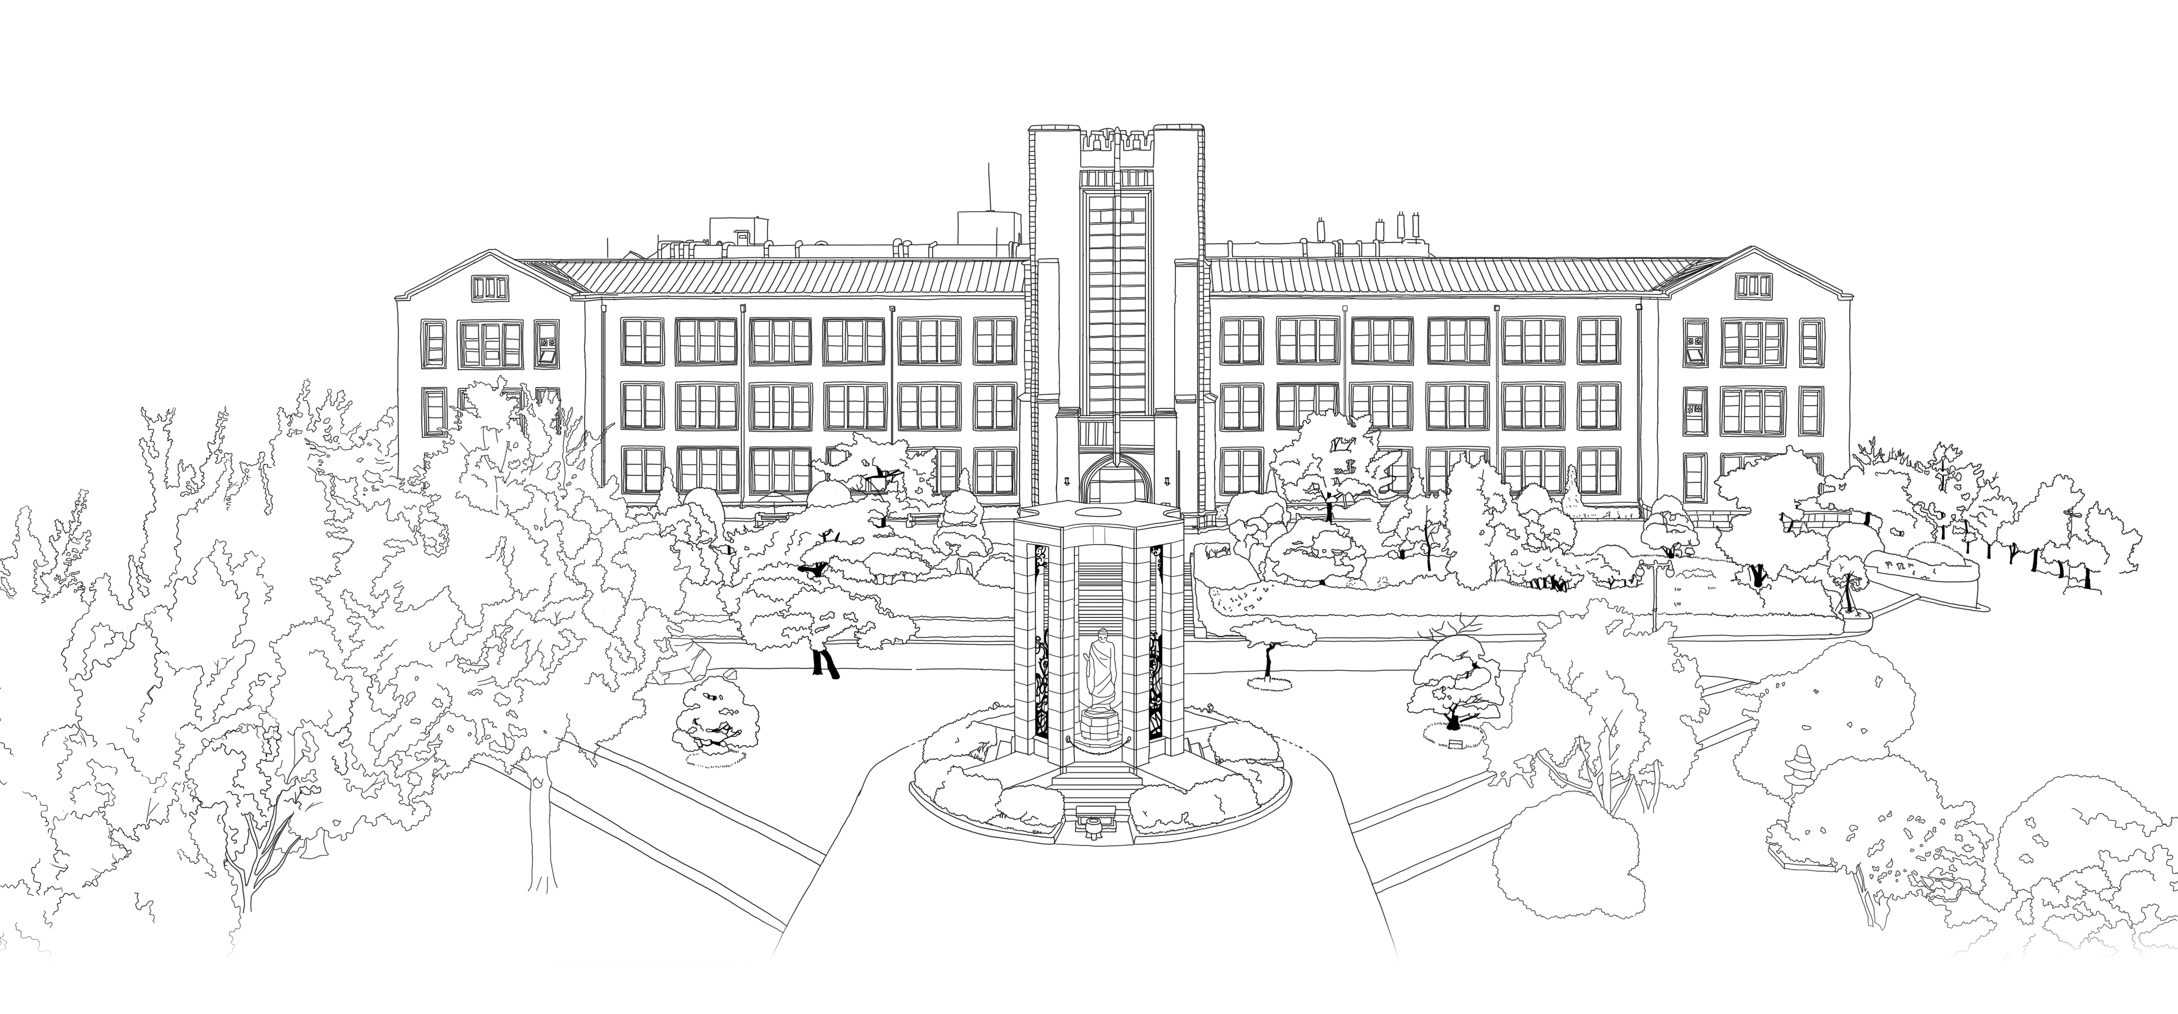


Introduction to Algorithms
DongYeon Kim
Department of Multimedia Engineering
Dongguk University

Slide 2
Contents
Chapter.2 Sorting and Order Statistics
Heapsort
Heaps
Maintaining the heap property
Building a heap
The heapsort algorithm
Priority queues
Quicksort
Description of quicksort
Performance of quicksort
A randomized version of quicksort
Sorting in Linear Time
Lower bounds for sorting
Counting sort
Radix sort
Bucket sort
Medians and Order Statistics
Minimum and maximum
Selection in expected linear time
Selection in worst-case linear time

Slide 3
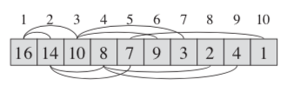
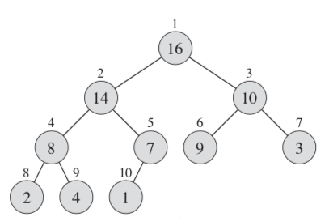
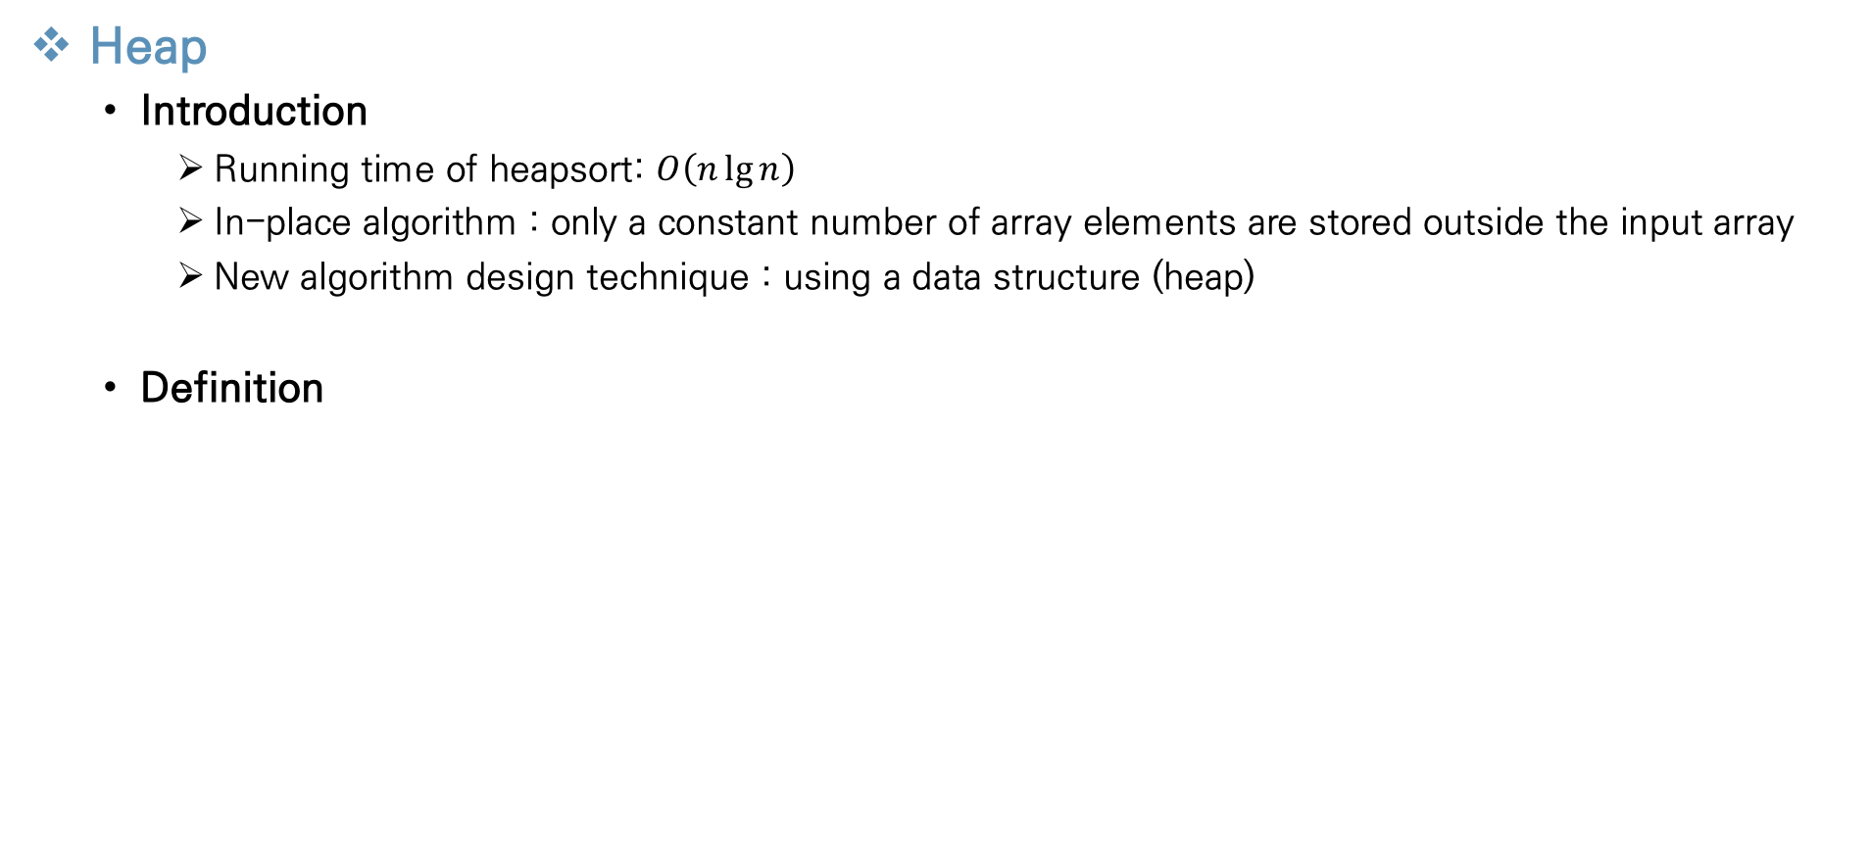
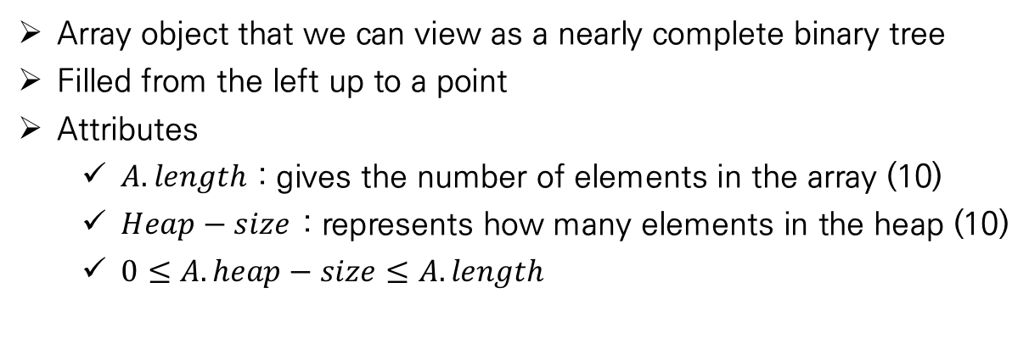
Heapsort
Heap
Introduction
Running time of heapsort: $O\left(n\lg{n}\right)$
In-place algorithm : only a constant number of array elements are stored outside the input array
New algorithm design technique : using a data structure (heap)
Definition
Array object that we can view as a nearly complete binary tree
Filled from the left up to a point
Attributes
$A.length$ : gives the number of elements in the array (10)
$Heap−size$ : represents how many elements in the heap (10)
$0≤A.heap−size≤A.length$
Notes:
Heap의 running time 과 inplace algorithm이라는 특성은 insertion sort와 merge sort의 단점들을 보완하며 Thus, heapsort combines the better attributes of the two sorting algorithms we have already discussed.
모든 array a 의 원소가 항상 heap으로 생성되는 것이 아니기 때문에 a.length 와 heap-size는 항상 같지 않다

Slide 4
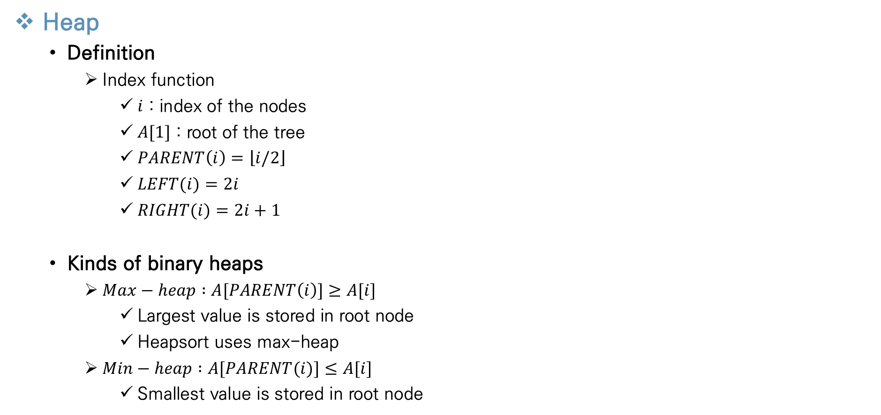
Heapsort
Heap
Definition
Index function
$i$ : index of the nodes
$A[1]$ : root of the tree
$PARENT\left(i\right)=\left\lfloor i/2\right\rfloor$
$LEFT(i)=2i$
$RIGHT(i)=2i+1$
Kinds of binary heaps
$Max−heap :A[PARENT\left(i\right)]≥A[i]$
Largest value is stored in root node
Heapsort uses max-heap
$Min−heap :A[PARENT(i)]≤A[i]$
Smallest value is stored in root node
Notes:
Max heap과 min heap 모두 heap property를 기본적으로 만족한다

Slide 5
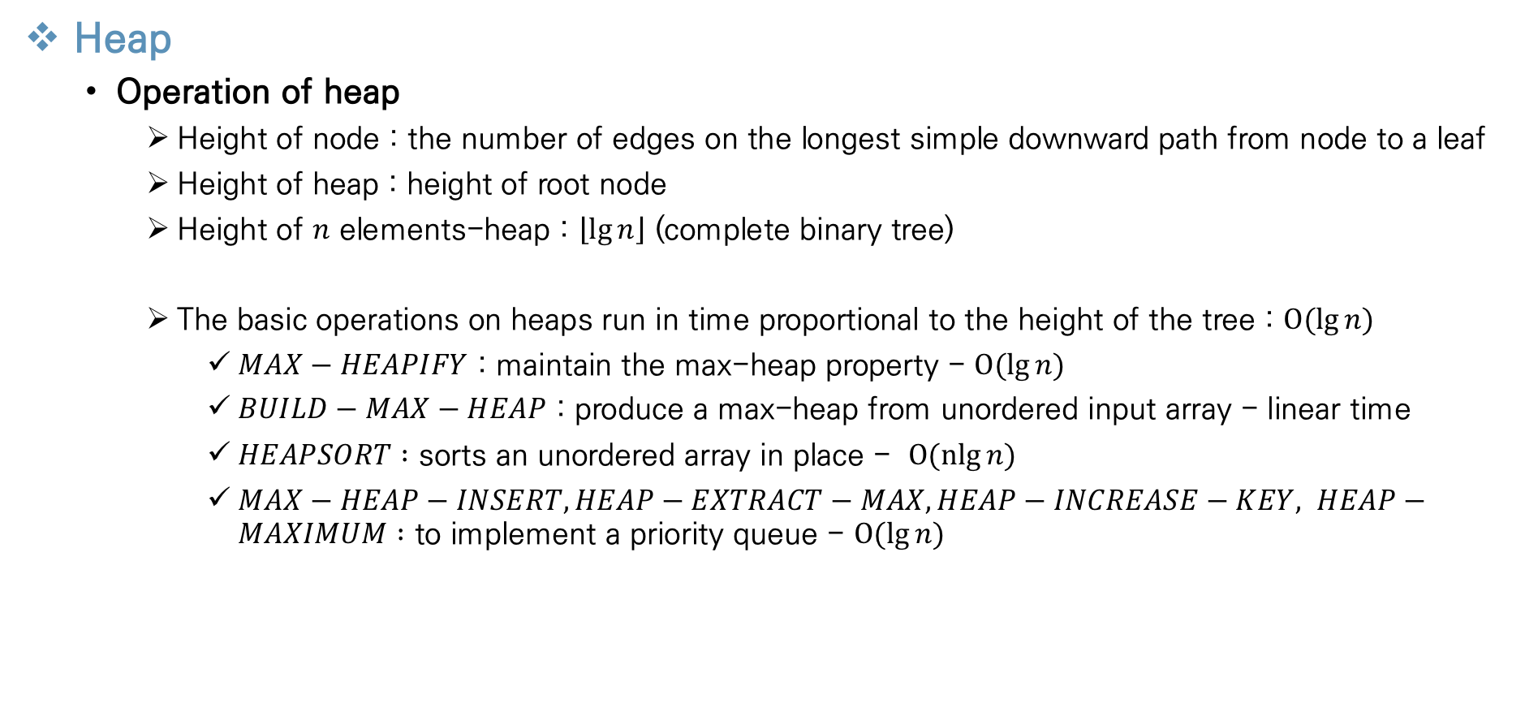
Heapsort
Heap
Operation of heap
Height of node : the number of edges on the longest simple downward path from node to a leaf
Height of heap : height of root node
Height of $n$ elements-heap : $\left\lfloor \lg{n}\right\rfloor$ (complete binary tree)
The basic operations on heaps run in time proportional to the height of the tree : $O(lg{n)}$
$MAX−HEAPIFY$ : maintain the max-heap property - $O(lg{n)}$
$BUILD−MAX−HEAP$ : produce a max-heap from unordered input array - linear time
$HEAPSORT :$ sorts an unordered array in place - 〖 $O(nlg{n)}$
$MAX−HEAP−INSERT, HEAP−EXTRACT−MAX, HEAP−INCREASE−KEY, HEAP−MAXIMUM :$ to implement a priority queue - $O(lg{n)}$
Notes:
Complete binary tree 이기 때문에 n개의 원소를 가지는 힙의 높이는 로그n이라는 것을 알아야한다
다음과 같은 operation 들이 존재하는데 하나씩 설명하겠다

Slide 6
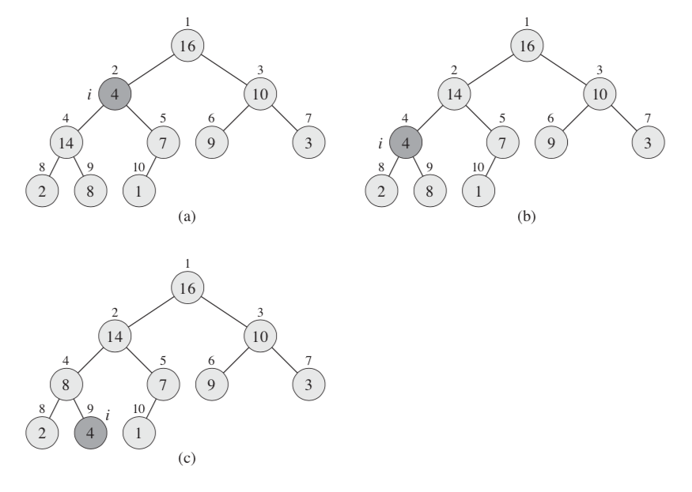
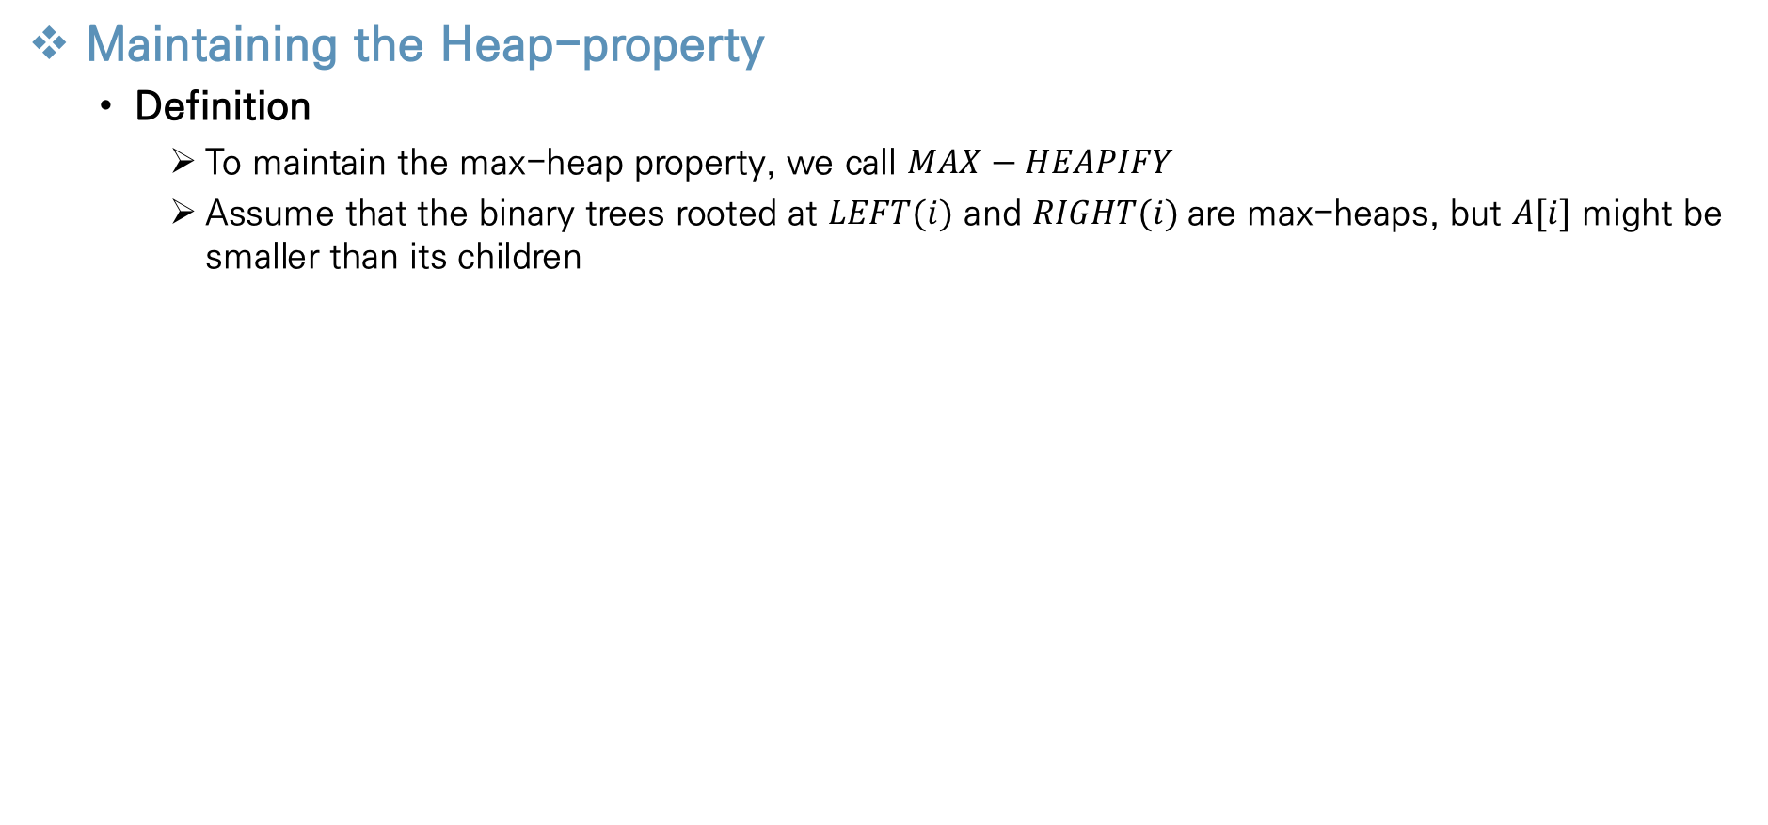
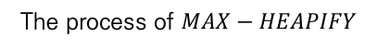
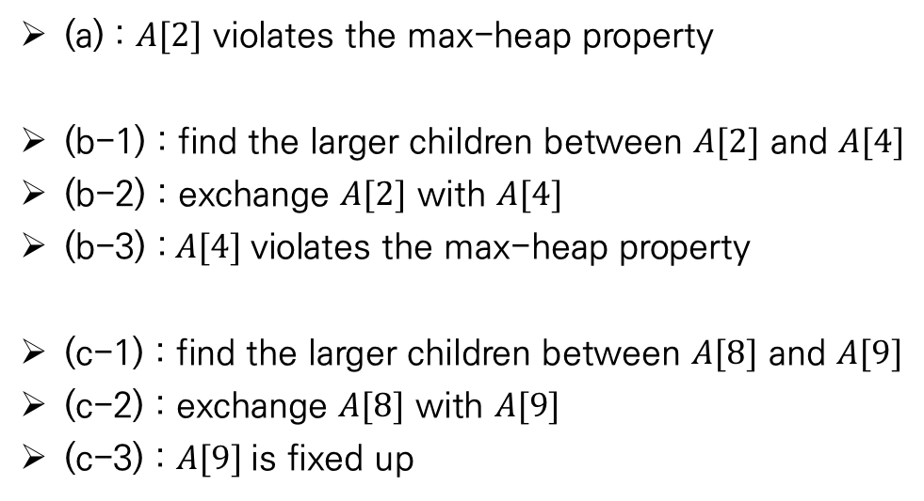
Heapsort
Maintaining the Heap-property
Definition
To maintain the max-heap property, we call $MAX−HEAPIFY$
Assume that the binary trees rooted at $LEFT(i)$ and $RIGHT(i)$are max-heaps, but $A[i]$ might be smaller than its children
(a) : $A[2]$ violates the max-heap property
(b-1) : find the larger children between $A[2]$ and $A[4]$
(b-2) : exchange $A[2]$ with $A[4]$
(b-3) :$A[4]$violates the max-heap property
(c-1) : find the larger children between $A[8]$ and $A[9]$
(c-2) : exchange $A[8]$ with $A[9]$
(c-3) : $A[9]$is fixed up
The process of $MAX−HEAPIFY$

Slide 7
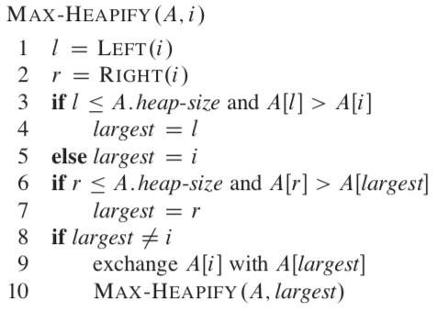
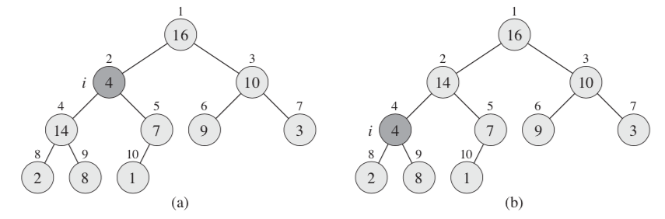
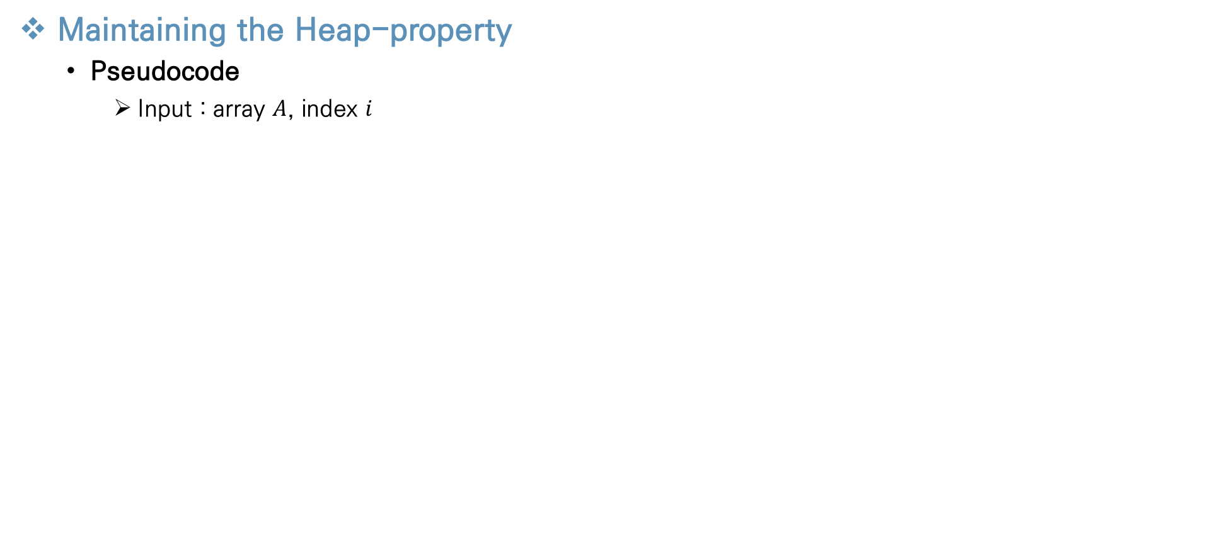
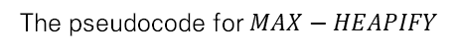
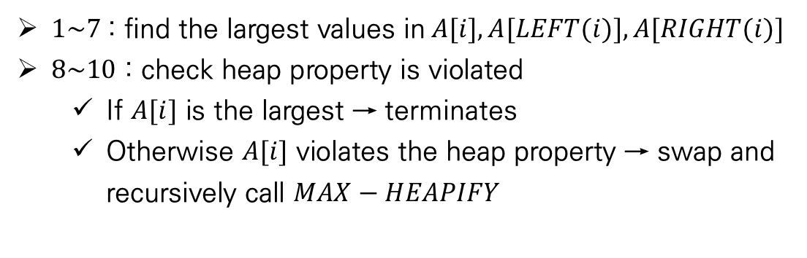
Heapsort
Maintaining the Heap-property
Pseudocode
Input : array $A$, index $i$
$1\sim 7$: find the largest values in$A[i], A[LEFT(i)], A[RIGHT(i)]$
$8\sim 10$ : check heap property is violated
If $A[i]$ is the largest → terminates
Otherwise $A[i]$ violates the heap property → swap and recursively call $MAX−HEAPIFY$
The pseudocode for $MAX−HEAPIFY$
Notes:
8 line 에서 ai가 largest이면 i를 루트로 하는 subtree는 이미 max heap상태로 함수 종료
반면에

Slide 8
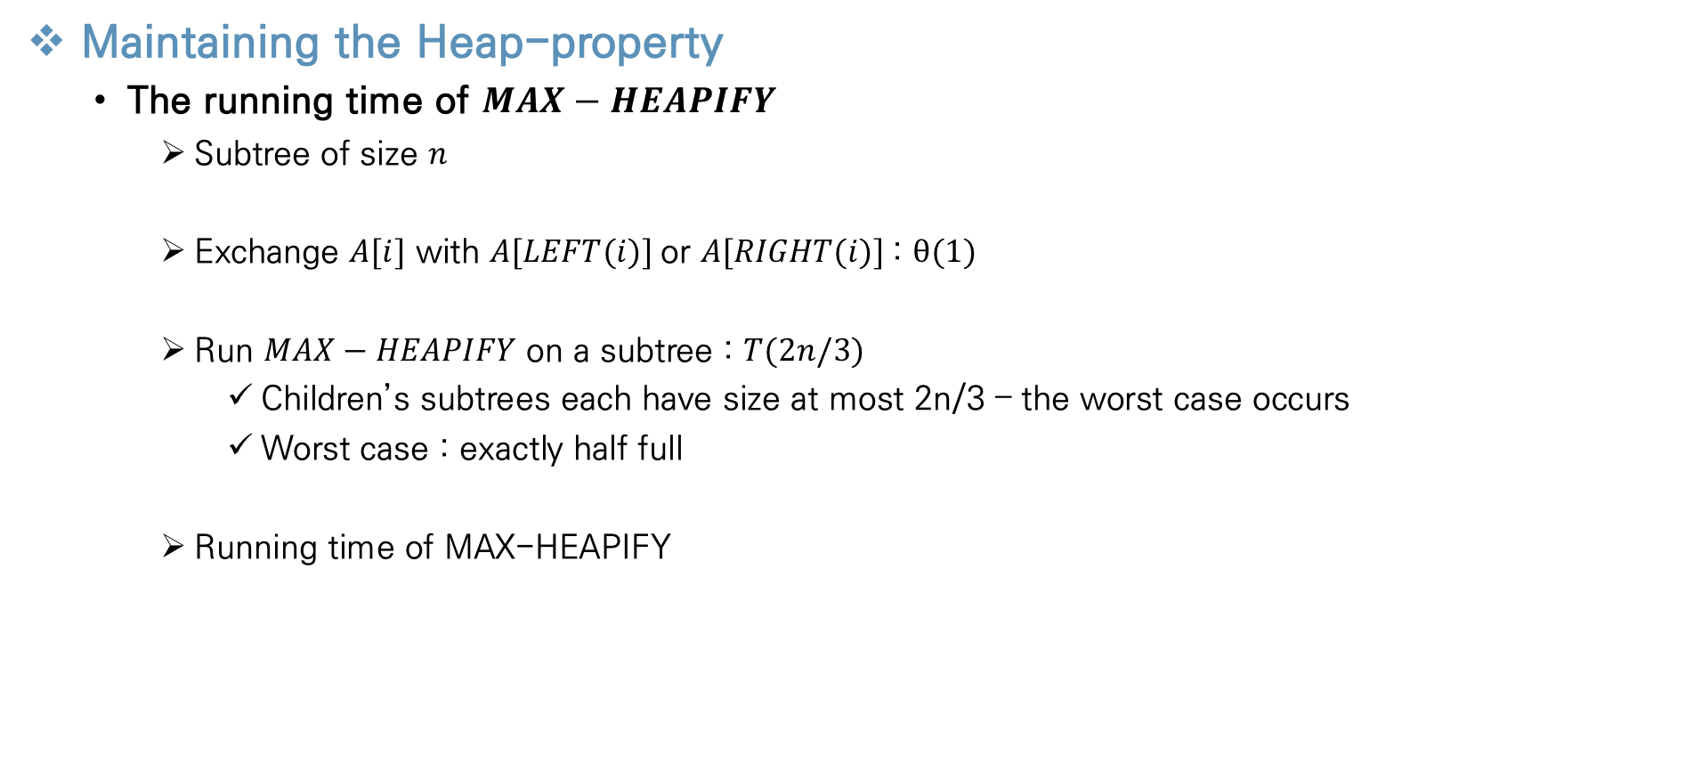
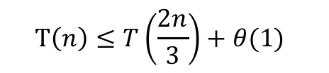
Heapsort
Maintaining the Heap-property
The running time of $MAX−HEAPIFY$
Subtree of size $n$
Exchange $A[i]$ with $A[LEFT(i)]$or $A[RIGHT(i)]$: $θ(1{)}$
Run $MAX−HEAPIFY$ on a subtree : $T(2n/3)$
Children’s subtrees each have size at most 2n/3 – the worst case occurs
Worst case : exactly half full
Running time of MAX-HEAPIFY
$$T\left(n\right)≤T\left(\frac{2n}{3}\right)+θ(1)$$
5
Notes:
모든 완전이진트리에서 반만 꽉찰 경우 2n/3개이다

Slide 9
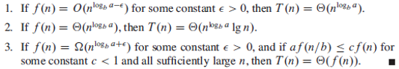
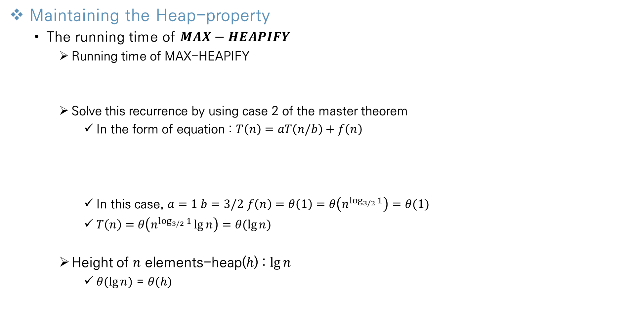
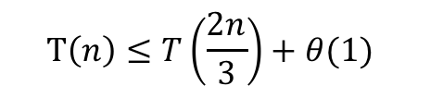
Heapsort
Maintaining the Heap-property
The running time of $MAX−HEAPIFY$
Running time of MAX-HEAPIFY
Solve this recurrence by using case 2 of the master theorem
In the form of equation : $T\left(n\right)=aT\left(n/b\right)+f\left(n\right)$
In this case, $a=1 b=3/2$ $f\left(n\right)=θ\left(1\right)=θ\left(n^{\log_{3/2}{1}}\right)=θ(1)$
$T\left(n\right)=θ\left(n^{\log_{3/2}{1}}\lg{n}\right)=$ $θ(\lg{n})$
Height of $n$ elements-heap($h$) : $\lg{n}$
$θ(\lg{n})$ = $θ(h)$
$$T\left(n\right)≤T\left(\frac{2n}{3}\right)+θ(1)$$
Notes:
모든 완전이진트리에서 반만 꽉찰 경우 2n/3개이다

Slide 10
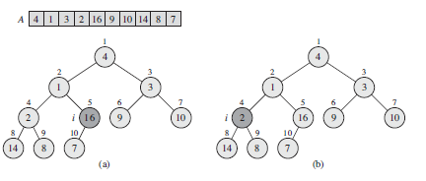
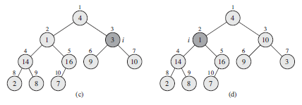
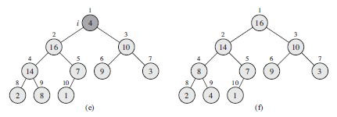
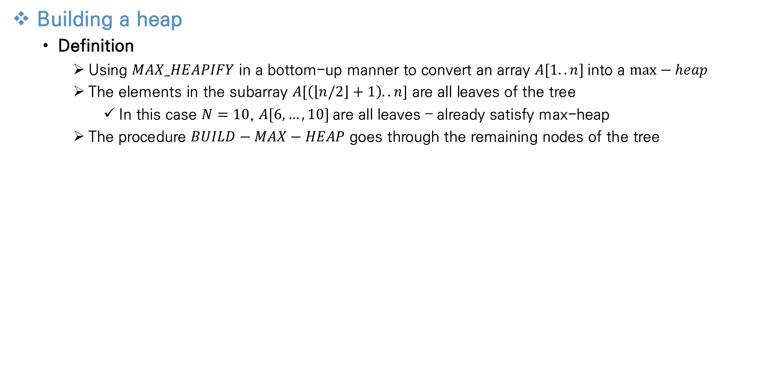
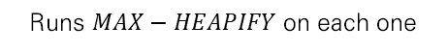
Heapsort
Building a heap
Definition
Using $MAX_HEAPIFY$ in a bottom-up manner to convert an array $A[1..n]$into a $max−heap$
The elements in the subarray $A[\left(\left\lfloor n/2\right\rfloor +1\right)..n]$ are all leaves of the tree
In this case $N=10$, $A[6,…,10]$are all leaves – already satisfy max-heap
The procedure $BUILD−MAX−HEAP$ goes through the remaining nodes of the tree
Runs $MAX−HEAPIFY$ on each one
Notes:
모든 완전이진트리에서 반만 꽉찰 경우 2n/3개이다

Slide 11
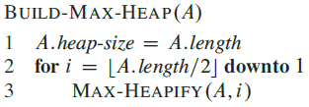
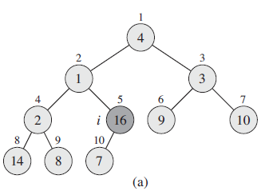
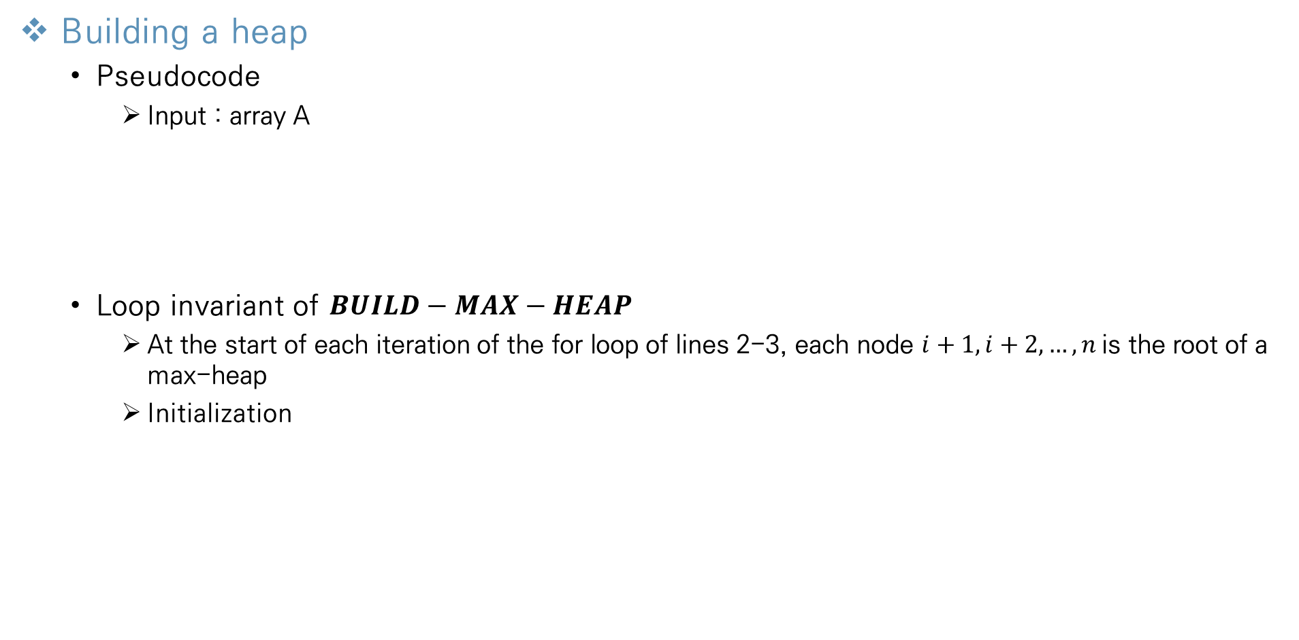
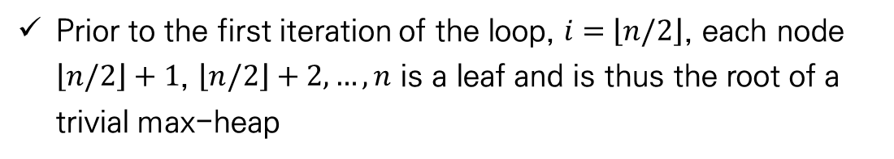
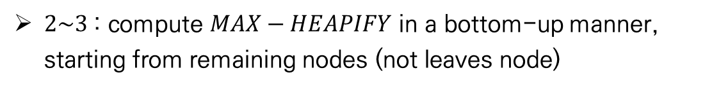
Heapsort
Building a heap
Pseudocode
Input : array A
Loop invariant of $BUILD−MAX−HEAP$
At the start of each iteration of the for loop of lines 2-3, each node $i+1, i+2,…,n$is the root of a max-heap
Initialization
$2\sim 3$: compute $MAX−HEAPIFY$ in a bottom-up manner, starting from remaining nodes (not leaves node)
Prior to the first iteration of the loop, $i=$ $\left\lfloor n/2\right\rfloor$, each node $\left\lfloor n/2\right\rfloor +1$, $\left\lfloor n/2\right\rfloor +2,…,n$ is a leaf and is thus the root of a trivial max-heap
Initial state
Notes:
Chapter 1 에서 공부했듯이 알고리즘의 타당성을 증명하기 위해 loop invariant를 분석하게 된다

Slide 12
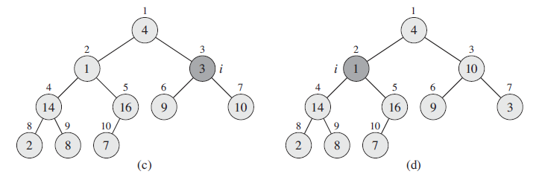
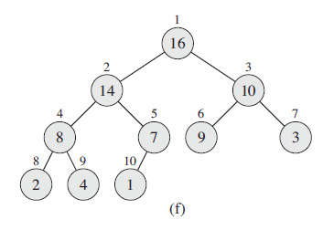
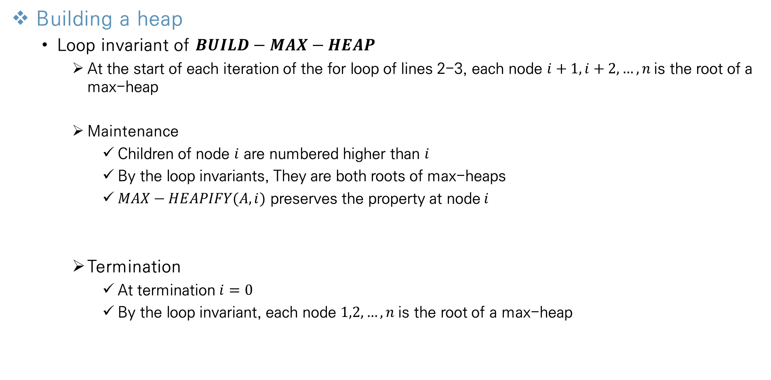
Heapsort
Building a heap
Loop invariant of $BUILD−MAX−HEAP$
At the start of each iteration of the for loop of lines 2-3, each node $i+1, i+2,…,n$is the root of a max-heap
Maintenance
Children of node $i$ are numbered higher than $i$
By the loop invariants, They are both roots of max-heaps
$MAX−HEAPIFY(A, i)$ preserves the property at node$i$
Termination
At termination $i=0$
By the loop invariant, each node $1,2,…,n$is the root of a max-heap
Maintenance state
Termination state
Notes:
Bottom up 으로 올라가기 때문에, 더 큰 index는 이미 max-heap의 root 이다

Slide 13
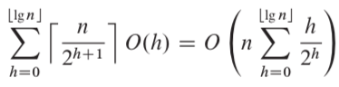
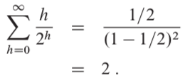
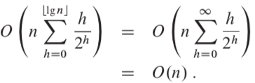
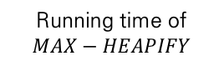
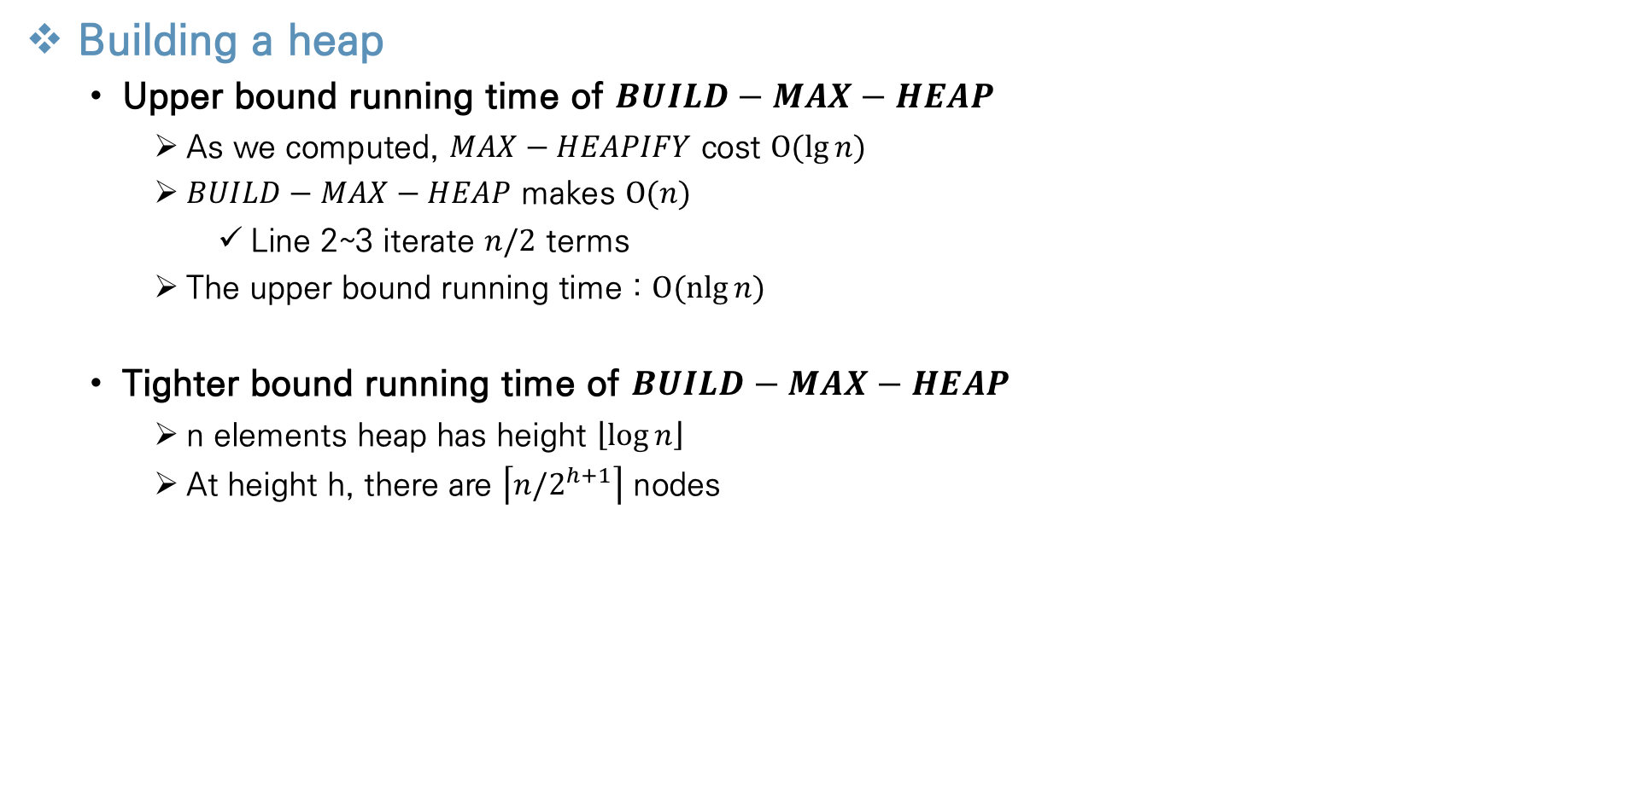
Heapsort
Building a heap
Upper bound running time of $BUILD−MAX−HEAP$
As we computed, $MAX−HEAPIFY$ cost $O(lg{n)}$
$BUILD−MAX−HEAP$ makes $O(n{)}$
Line 2~3 iterate $n/2$ terms
The upper bound running time : $O(nlg{n)}$
Tighter bound running time of $BUILD−MAX−HEAP$
n elements heap has height $\left\lfloor \log{n}\right\rfloor$
At height h, there are $\left\lceil n/2^{h+1}\right\rceil$ nodes
The number of node at level h
Iterates whole levels
Running time of $MAX−HEAPIFY$
Notes:
Bottom up 으로 올라가기 때문에, 더 큰 index는 이미 max-heap의 root 이다

Slide 14
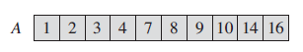
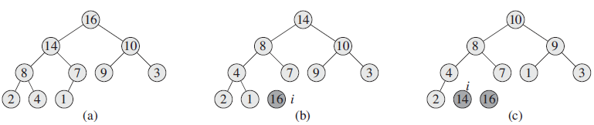
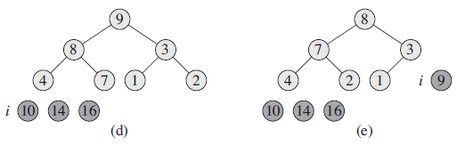
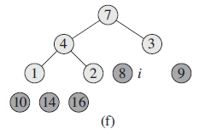
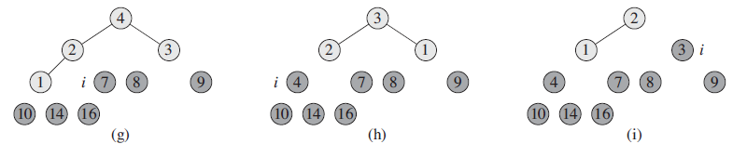
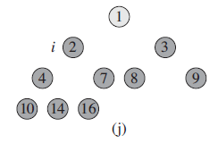
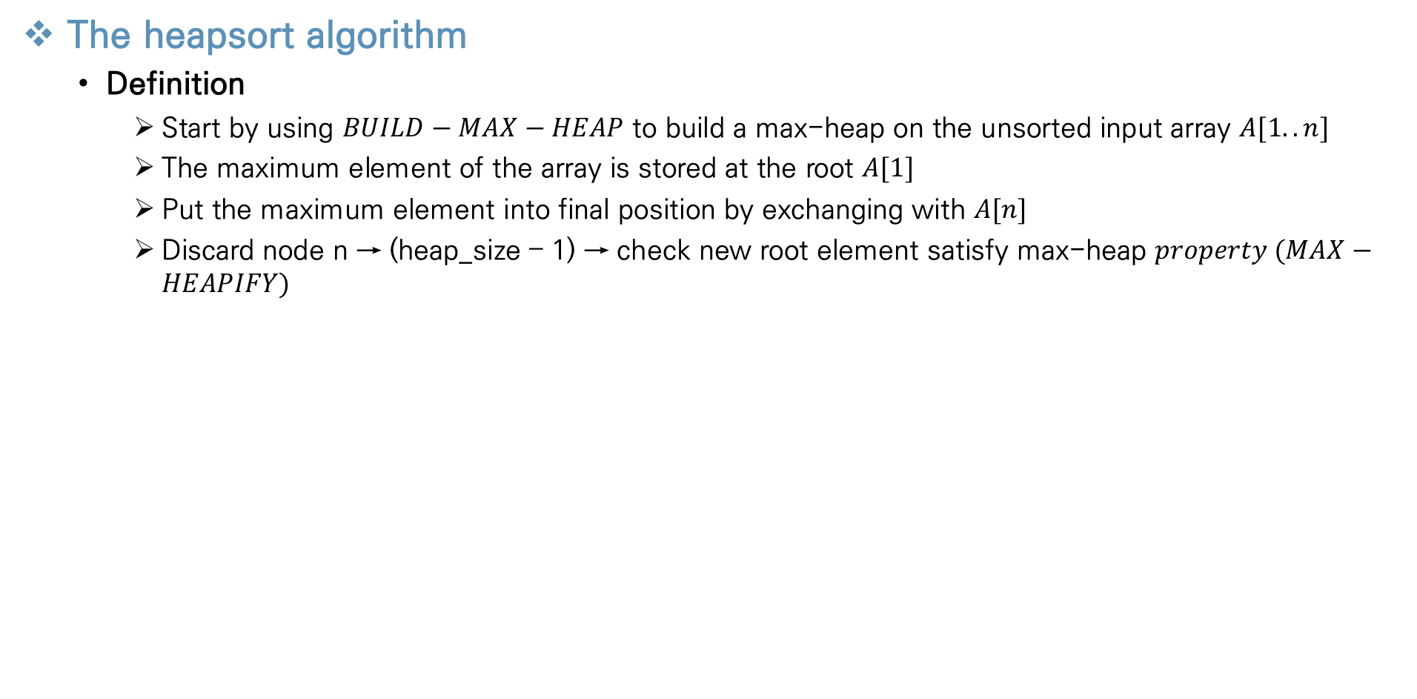
Heapsort
The heapsort algorithm
Definition
Start by using $BUILD−MAX−HEAP$ to build a max-heap on the unsorted input array $A[1..n]$
The maximum element of the array is stored at the root $A[1]$
Put the maximum element into final position by exchanging with $A[n]$
Discard node n → (heap_size – 1) → check new root element satisfy max-heap $property (MAX−HEAPIFY)$
Notes:
Bottom up 으로 올라가기 때문에, 더 큰 index는 이미 max-heap의 root 이다

Slide 15
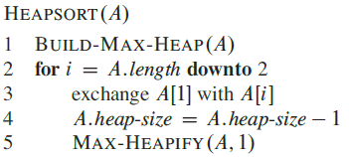
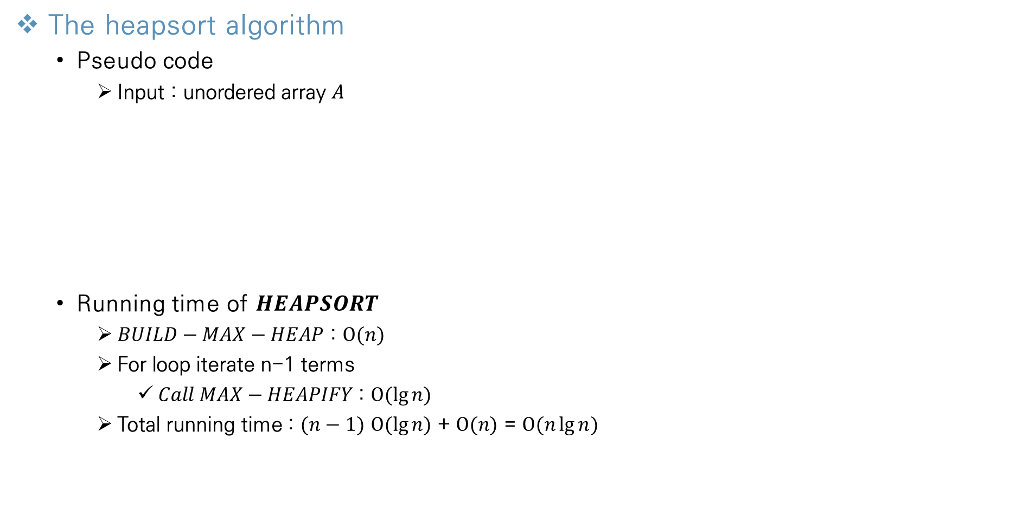
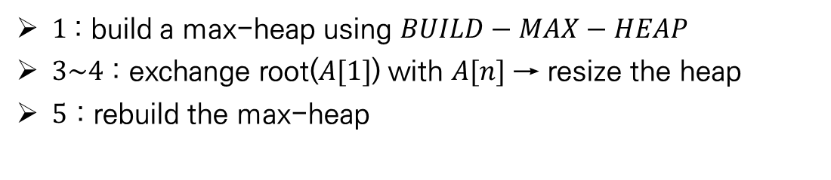
Heapsort
The heapsort algorithm
Pseudo code
Input : unordered array $A$
Running time of $HEAPSORT$
$BUILD−MAX−HEAP$ : $O(n{)}$
For loop iterate n-1 terms
$Call MAX−HEAPIFY$: $O(\lg{n}{)}$
Total running time : $(n−1)$ $O(\lg{n}{)}$ + $O(n{)}$ = $O(n\lg{n}{)}$
$1$: build a max-heap using $BUILD−MAX−HEAP$
$3\sim 4$ : exchange root($A[1]$) with $A[n]$ → resize the heap
$5$ : rebuild the max-heap
Notes:
Bottom up 으로 올라가기 때문에, 더 큰 index는 이미 max-heap의 root 이다

Slide 16
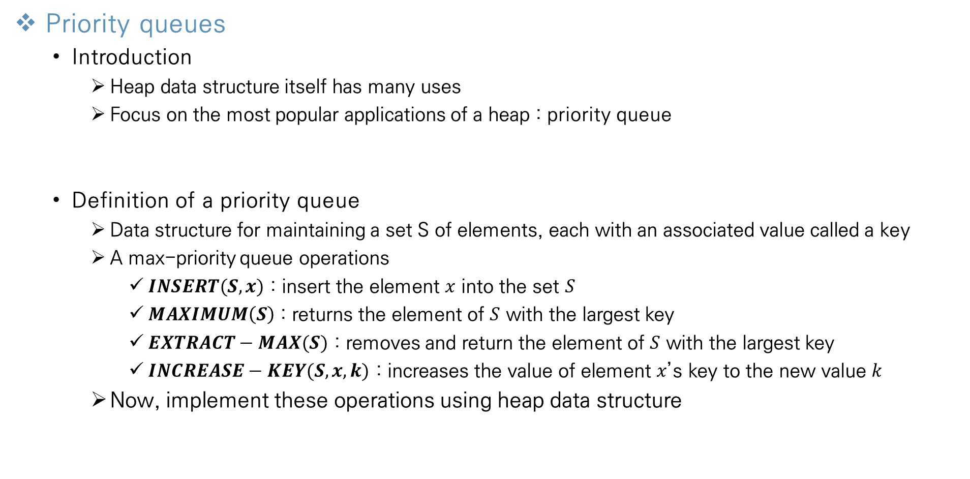
Heapsort
Priority queues
Introduction
Heap data structure itself has many uses
Focus on the most popular applications of a heap : priority queue
Definition of a priority queue
Data structure for maintaining a set S of elements, each with an associated value called a key
A max-priority queue operations
$INSERT(S,x)$ : insert the element $x$ into the set $S$
$MAXIMUM\left(S\right)$ : returns the element of $S$ with the largest key
$EXTRACT−MAX(S)$ : removes and return the element of $S$ with the largest key
$INCREASE−KEY(S, x, k)$ : increases the value of element $x$’s key to the new value $k$
Now, implement these operations using heap data structure
Notes:
Bottom up 으로 올라가기 때문에, 더 큰 index는 이미 max-heap의 root 이다

Slide 17




Heapsort
Priority queues
$MAXIMUM(S)$
The procedure $HEAP−MAXIMUM$ implements the $MAXIMUM$ operation
Takes $θ(1)$ time
$EXTRACT−MAX$(S)
The procedure $HEAP−EXTRACT−MAX$ implements the $EXTRACT−MAX$ operation
Similar to $HEAPSORT$ loop procedure
Takes $O(\lg{n}{)}$ time for $MAX−HEAPIFY$
$3\sim 4 :$ save the largest element ($A[1]$) & swapping with $A[n]$
$5\sim 6 :$ rebuild the max-heap
$7$ : Return the largest value

Slide 18



Heapsort
Priority queues
$INCREASE−KEY(S,x,k)$
The procedure $HEAP−INCREASE−KEY$ implements the $INCREASE−KEY$ operation
Index $i$ node want to increase key to a new value → violates max-heap property
$(a)$ : update the $i$ node’s key to a new value
$(b)$ : new key violates the max-heap property
$(c)$ : exchange with parents
$(d)$ : iterate $(c)$ process toward the root until finding a proper place for newly increased key

Slide 19



Heapsort
Priority queues
$INCREASE−KEY(S,x,k)$
The running time of $HEAP−INCREASE−KEY$ : $O(\lg{n}{)}$
Find proper place of newly increased key → Traverse from node $i$ to root
The height of the tree : $\lg{n}$
$3$ : change key value of node $i$
$4\sim 6$ : exchange with its parent until find proper place

Slide 20



Heapsort
Priority queues
$INSERT−KEY(S,x,k)$
The procedure $MAX−HEAP−INSERT$ implements the $INSERT$ operation
The running time of $MAX−HEAP−INSERT$ : $O(\lg{n}{)}$
$HEAP−INCREASE−KEY$
Conclusion
A heap can support any priority-queue’s operation in $O(\lg{n}{)}$ time
$1$ : expand the heap-size
$2$ : add to the tree a new leaf whose key is -$∞$
$3$ : find proper place of new node using $HEAP−INCREASE−KEY$

Slide 21
Contents
Chapter.2 Sorting and Order Statistics
Heapsort
Heaps
Maintaining the heap property
Building a heap
The heapsort algorithm
Priority queues
Quicksort
Description of quicksort
Performance of quicksort
A randomized version of quicksort
Sorting in Linear Time
Lower bounds for sorting
Counting sort
Radix sort
Bucket sort
Medians and Order Statistics
Minimum and maximum
Selection in expected linear time
Selection in worst-case linear time
Notes:
모든 Feature마다 이상치를 제거하게 되면 너무 많은 데이터 손실이 발생

Slide 22


Quicksort
Description of Quicksort
Introduction
Worst-case running time : $θ(n^{2})$
Average-case running time : $θ(\operatorname{nlg}{n})$
In-place sorting algorithm
Divide-and-Conquer
Quicksort applies the divide-and-conquer paradigm
Divide
Partition the array $A[p..r]$into two subarray $A[p..q−1]$and$A[q+1..r]$
Each element of $A[p,,q−1]$is less than or equal to $A[q]$
Compute the index $q$ as part of partitioning procedure
Conquer
Sort the two subarrays $A[p..q−1]$and $A[q+1..r]$by recursive calls to quicksort
Combine
Because the Subarrays are already sorted, no work is needed to combine
q

Slide 23






Quicksort
Description of Quicksort
Procedure of quicksort
Partitioning the array
The key procedure of the quicksort algorithm
Rearrange the subarray $A[p..r]$
Select an element $x=A[r]$ as a pivot element which to partition the subarray
Partition the array into four regions
$2$ : divide the unsorted array $A$ using $PARTITION$
$3\sim 4$ : conquer the subarray by recursive call
Lower than $x$
higher than $x$
Not arranged
Pivot element

Slide 24


Quicksort
Description of Quicksort
Partitioning the array
$(a)$ : initial state, pivot element is $A[r]$
$(b)$ : the value 2 is “swapped with itself” and put in the partition of smaller values
$\left(c\right) (d)$ : increase index j, because value 8, 7 is larger than pivot, added to the partition of larger values
$(e)$ : swap $A[i]$ and $A[j]$, value 1 and 8
$\left(f\right)$ : swap value 3 and 7
$\left(g\right) (h)$ : the larger partition grows to include 5 and 6 and loop terminates
$(i)$ : the pivot element is swapped

Slide 25






Quicksort
Description of Quicksort
Pseudocode for Partitioning
$1$ : initialize the pivot $x$ and index $i$
$3\sim 6$ : compare $A[j]$ with pivot $x$, increasing index $j$
If $A\left[j\right]≤pivot$ : increase $i$ and exchange $A[i]$ with $A[j]$
Otherwise : only increase index $j$
$7\sim 8$ : exchange pivot with $A[i+1]$
Line 1
Line 3~6
First case
Line 3~6
Second case
Line 7~8

Slide 26



Quicksort
Description of Quicksort
Loop invariant of $PARTITION$
For any array index k, always satisfy these three property
Initialization
Prior to the first iteration of the loop, $i=p−1$and $j=p$
No value lie between $p$ and $i$ and between $i+1$ and $j−1$
Loop invariant property 1,2 was satisfied
Loop invariant property 3 is always true, because of line 1
all elements of $A[p..i]$are always smaller than $x$
all elements of $A[i+1..j−1]$are always larger than $x$
$A[r]$ is a pivot element

Slide 27


Quicksort
Description of Quicksort
Loop invariant of $PARTITION$
Maintenance
Consider two cases, depending on outcome of the test in line 4
First case $(a)$: $A\left[j\right]>x$
Only action in the loop is to increment j
After j incremented, condition 2 holds for $A[j−1]$and all other entries remain unchanged
Second case $(b)$ : $A[j]≤x$
The loop increments index$i$
Swap $A[i]$ and $A[j]$, and then increments $j$
$A[i]≤x$ and $A[j−1]≥x$
$A[i]≤x$Condition 1,2 holds
all elements of $A[p..i]$are always smaller than $x$
all elements of $A[i+1..j−1]$are always larger than $x$
$A[r]$ is a pivot element

Slide 28

Quicksort
Description of Quicksort
Loop invariant of $PARTITION$
Termination
At termination $j=r$, therefore every entry in the array is in one of the three sets described by the invariant
The running time of $PARTITION$
$θ(n{)}$
Index j iterate n-1 terms
all elements of $A[p..i]$are always smaller than $x$
all elements of $A[i+1..j−1]$are always larger than $x$
$A[r]$ is a pivot element

Slide 29



Quicksort
Performance of Quicksort
Worst-case Partitioning
Worst-case behavior for quicksort occurs when the partitioning routine produces one subproblem with $n−1$ elements and one with 0 elements
Assume that this unbalanced partitioning arises in each recursive call
The running time of $PARTITION$ : $θ(n{)}$
The running time of $PARTITION$ in array size 0 (just return) : $θ(1{)}$
The running time of next iteration $PARTITION$ : $T(n−1)$
4 | 6 | 8 | 9 | 7 | 10 | 5
pivot
arranged
4 | 5 | 8 | 9 | 7 | 10 | 6
pivot
arranged

Slide 30


Quicksort
Performance of Quicksort
Best-case Partitioning
Best-case behavior for quicksort occurs when the partitioning routine produces each size $\left\lfloor n/2\right\rfloor$ and $\left\lceil n/2−1\right\rceil$
Assume that this balanced partitioning arises in each recursive call
The running time of $PARTITION$ : $θ(n{)}$
The running time of next iteration $PARTITION$ : 2$T(n/2)$
Using master theorem, $T(n)=θ(n{\lg{n})}$
2 | 3 | 1 | 4 | 7 | 10 | 5
arranged
pivot
arranged
1 | 2 | 3 | 4 | 5 | 7 | 10
pivot
pivot

Slide 31


Quicksort
Performance of Quicksort
average-case Partitioning
Expect that some of the splits will be reasonably well balanced and that some will be fairly unbalanced
$PARTITION$ produces a mix of “good” and “bad” splits
(a) : mix of “bad” and “good” split = takes partitioning cost $θ(n{)}$ + $θ(n{−1)}$ = $θ(n{)}$
(b) : only “good” split = takes partitioning cost $θ(n{)}$
The cost of (a) and (b) are same!!
In average case the running time for partitioning is similar with best-case, still have $O(n{\lg{n})}$ time

Slide 32
Thank You!

